Slide 1
Artificial Intelligence
Convolutional Neural Networks
David Li

Slide 2
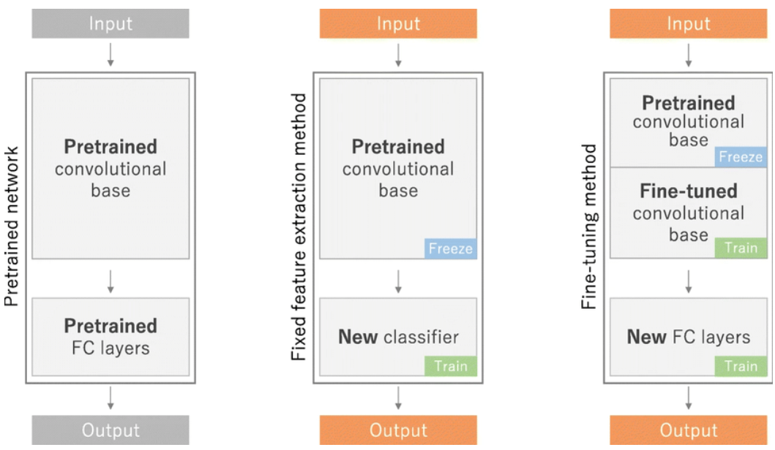
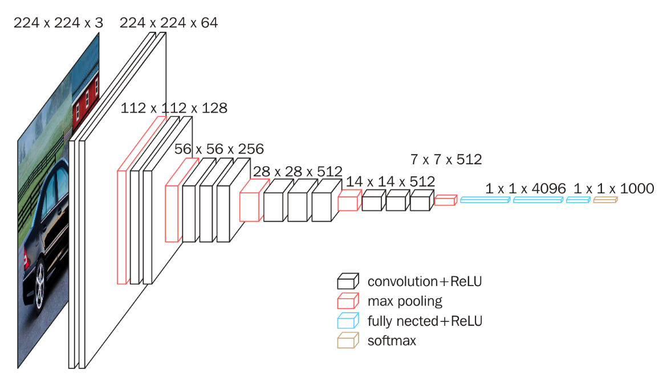
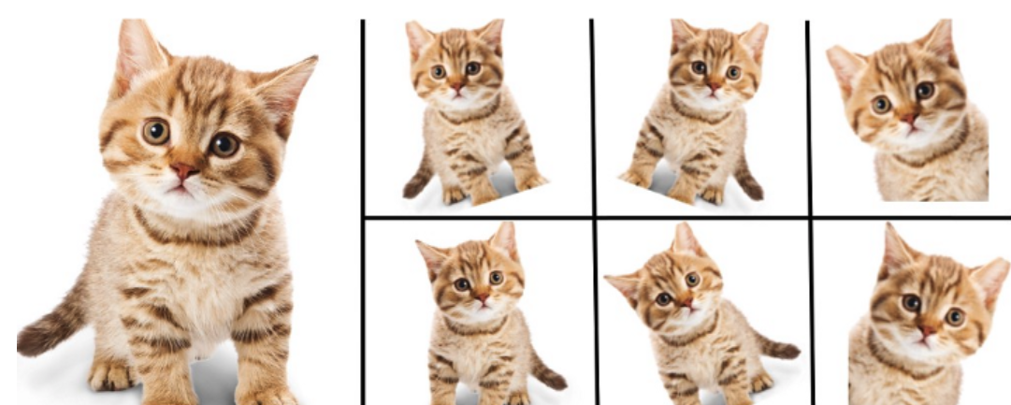
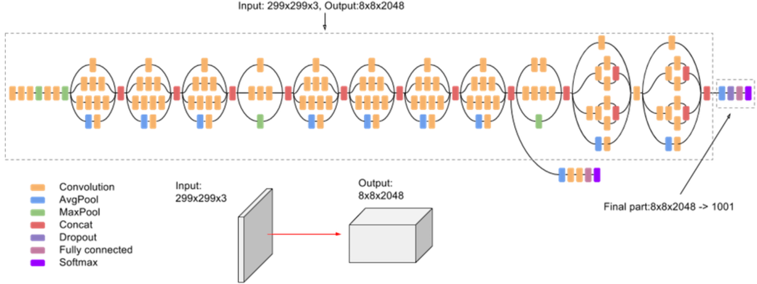
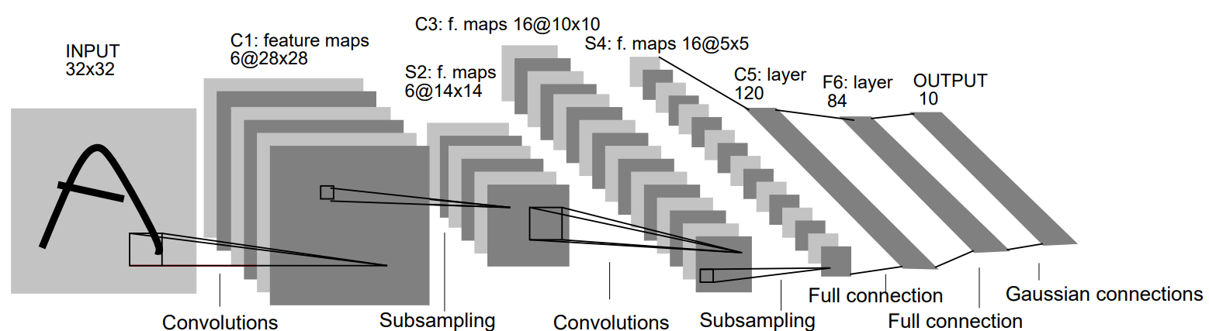
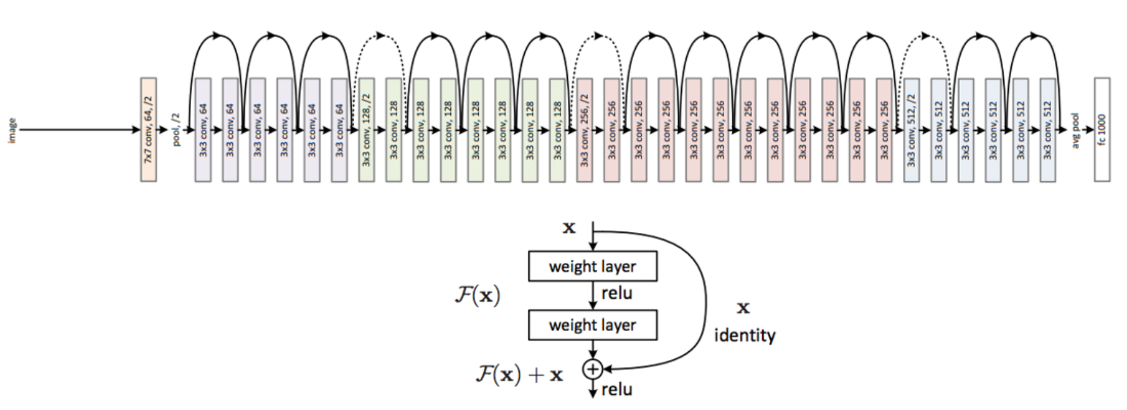
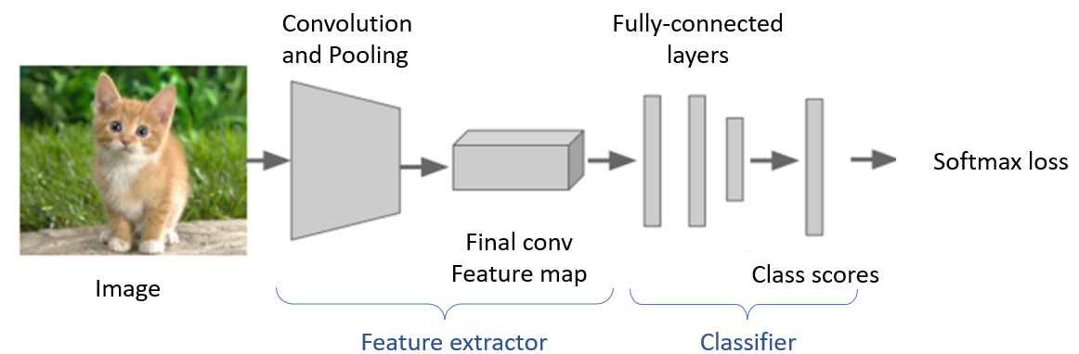
Outline
VGG16
Fine Tune
Data Augmentation
Inception_V3
LeNet
Feature Extraction
ResNet50

Slide 3
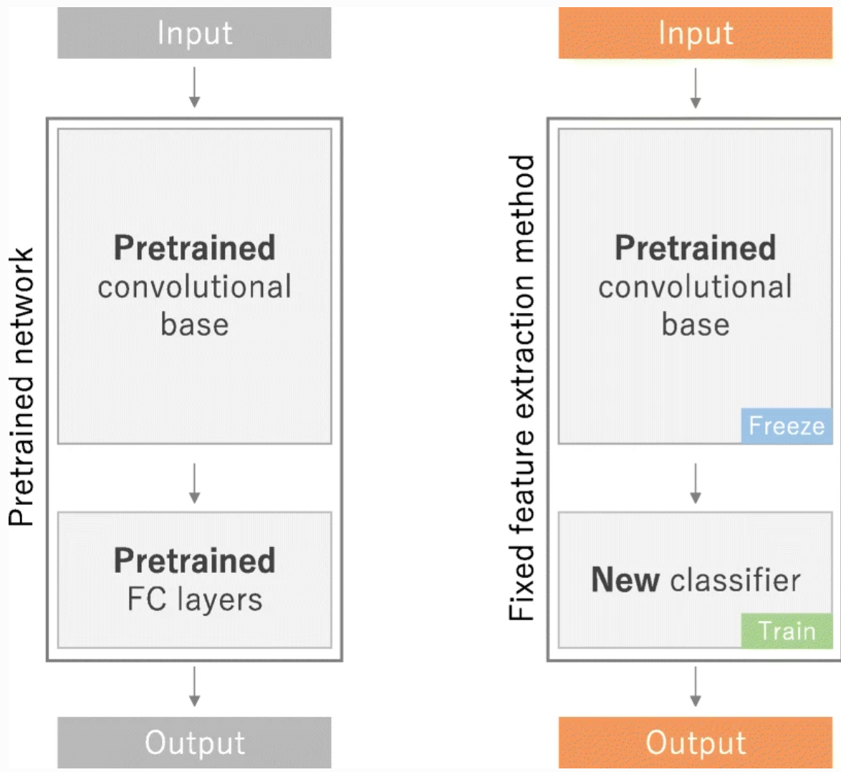
Comparison of Validation Accuracy by Different Models(Freeze)
2

Slide 4

Inception_V3(Freeze Conv Base)
$$+$$

Slide 5

Convolutional Neural Network by Inception_V3 - Freeze Conv Base
Step 1.準備dogs-vs-cats資料
from google.colab import files
files.upload()
!mkdir ~/.kaggle
!cp kaggle.json ~/.kaggle/
!chmod 600 ~/.kaggle/kaggle.json
!kaggle competitions download -c dogs-vs-cats
!unzip -qq dogs-vs-cats.zip
!unzip -qq train.zip
import os, shutil, pathlib
original_dir = pathlib.Path("train")
new_base_dir = pathlib.Path("cats_vs_dogs_small") def make_subset(subset_name, start_index, end_index):
for category in ("cat", "dog"):
dir = new_base_dir / subset_name / category
os.makedirs(dir)
fnames = [f"{category}.{i}.jpg" for i in range(start_index, end_index)]
for fname in fnames:
shutil.copyfile(src=original_dir / fname,
dst=dir / fname)
make_subset("train", start_index=0, end_index=1000)
make_subset("validation", start_index=1000, end_index=1500)
make_subset("test", start_index=1500, end_index=2500)
以圖片"cat.0.jpg"為例，原檔案路徑為/content/train/cat.0.jpg
檔案欲複製到的資料夾名稱
src:source-檔案的來源位址; dst:destination-欲將檔案複製到的資料夾的位址
將檔案複製到資料夾:cats_vs_dogs_small => train => cat or dog各1000張

Slide 6
Convolutional Neural Network by Inception_V3 - Freeze Conv Base
Step 2.使用image_dataset_from_directory()來讀取影像
from tensorflow.keras.utils import image_dataset_from_directory
train_dataset = image_dataset_from_directory(
new_base_dir / "train",
image_size=(180, 180),
batch_size=32)
validation_dataset = image_dataset_from_directory(
new_base_dir / "validation",
image_size=(180, 180),
batch_size=32)
test_dataset = image_dataset_from_directory(
new_base_dir / "test",
image_size=(180, 180),
batch_size=32)
以讀取上述train資料夾為例，可得到分成兩類的圖檔共2000張(貓狗各1000張)，且分為32個batch
train資料夾中共有2個子資料夾，分別為cat跟dog，以指令"image_dataset_from_directory"讀取檔案後，會自動分為2類
圖片像素為180*180，且有R、G、B 3個channel
每個batch取32張圖片
Step 3.建立Inception_V3模型並設定compile
from tensorflow import keras
from tensorflow.keras import layers
conv_base = tf.keras.applications.InceptionV3(
include_top=False,
weights='imagenet')
conv_base.trainable = False
下載並加載預訓練的InceptionV3模型
包含頂層全連接層
使用在ImageNet上預訓練的權重
凍結捲積基底的權重
使輸入圖像與模型訓練時使用的圖像具有相同的數據分佈，從而提高預測的準確性和穩定性
Inputs = keras.Input(shape = (180, 180, 3) )
x = tf.keras.applications.inception_v3.preprocess_input(Inputs)
x = conv_base(x)
x = layers.Flatten()(x)
x = layers.Dense(256, activation="relu")(x)
outputs = layers.Dense(1, activation="sigmoid")(x)
model = keras.Model(inputs=Inputs, outputs=outputs)
model.compile(loss="binary_crossentropy",
optimizer="rmsprop",
metrics=["accuracy"])

Slide 7
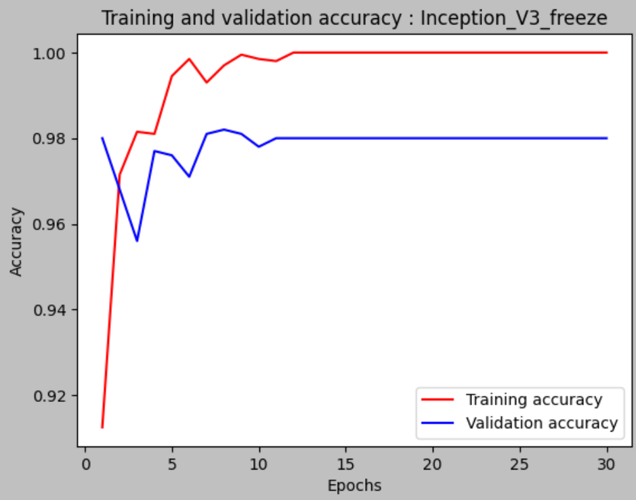
Convolutional Neural Network by Inception_V3 - Freeze Conv Base
Step 4.建立callbacks並開始訓練模型
callbacks = [
keras.callbacks.ModelCheckpoint(
"CNN_for_Inception_V3_freeze",
save_best_only=True, )]
history_for_Inception_V3_freeze = model.fit(
train_dataset,
epochs=30,
validation_data=validation_dataset,
callbacks=callbacks)
train_dataset已包含images及labels,故不須輸入labels資料
Step 5.畫出train_data與validation data的accuracy
import matplotlib.pyplot as plt
acc = history_for_Inception_V3_freeze.history["accuracy"]
val_acc = history_for_Inception_V3_freeze.history["val_accuracy"]
epochs = range(1, len(val_acc) + 1)
plt.plot(epochs, acc, "r", label="Training accuracy")
plt.plot(epochs, val_acc, "b", label="Validation accuracy")
plt.title("Training and validation accuracy : Inception_V3_freeze")
plt.xlabel("Epochs")
plt.ylabel("Accuracy")
plt.legend()
plt.show()

Slide 8

VGG16 (Freeze Conv Base)
$$+$$

Slide 9
Convolutional Neural Network by VGG16 - Freeze Conv Base
Step 3.建立VGG16的convolutional base及模型，並設定compile
conv_base = keras.applications.vgg16.VGG16(
weights="imagenet",
include_top=False,
input_shape=(180, 180, 3))
conv_base.trainable = False
下載並加載預訓練的VGG16模型
指定用於初始化模型的權重(本例是使用以ImageNet訓練好的參數)
代表要不要包含VGG16頂部的密集連接分類器
提供給神經網路的影像張量的shape，如果不傳遞此參數，則神經網路將能夠處理任何shape的輸入張量
inputs = keras.Input(shape = (180, 180, 3) )
tf.keras.applications.vgg16.preprocess_input(inputs)
x = conv_base(Inputs)
x = layers.Flatten()(x)
x = layers.Dense(256, activation="relu")(x)
outputs = layers.Dense(1, activation="sigmoid")(x)
model = keras.Model(inputs=Inputs, outputs=outputs)
凍結捲積基底的權重
使輸入圖像與模型訓練時使用的圖像具有相同的數據分佈，從而提高預測的準確性和穩定性。
model.compile(loss="binary_crossentropy",
optimizer="rmsprop",
metrics=["accuracy"])
Step 4.建立callbacks並開始訓練模型
callbacks = [
keras.callbacks.ModelCheckpoint(
filepath="CNN_for_VGG16_freeze",
save_best_only=True,
)]
history_for_VGG16 = model.fit(
train_dataset,
epochs=30,
validation_data=validation_dataset,
callbacks=callbacks)

Slide 10
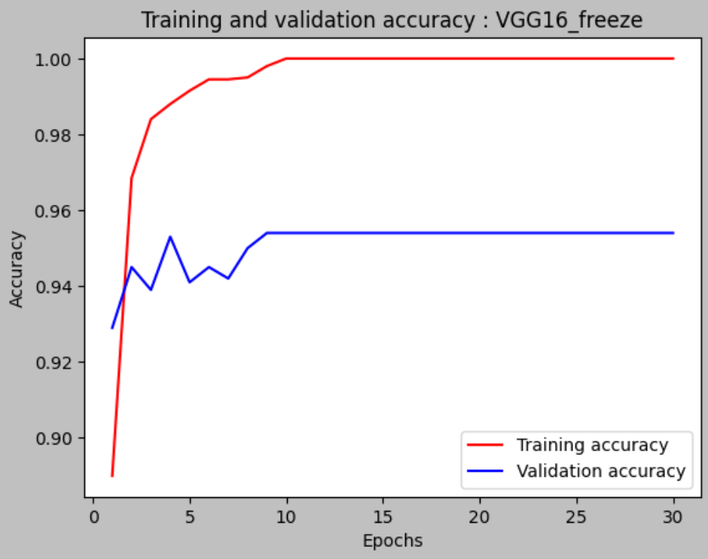
Convolutional Neural Network by VGG16 - Freeze Conv Base
Step 5.畫出train_data與validation data的accuracy
import matplotlib.pyplot as plt
acc = history_for_VGG16_freeze.history["accuracy"]
val_acc = history_for_VGG16_freeze.history["val_accuracy"]
epochs = range(1, len(val_acc) + 1)
plt.plot(epochs, acc, "r", label="Training accuracy")
plt.plot(epochs, val_acc, "b", label="Validation accuracy")
plt.title("Training and validation accuracy : VGG16_freeze")
plt.xlabel("Epochs")
plt.ylabel("Accuracy")
plt.legend()
plt.show()

Slide 11
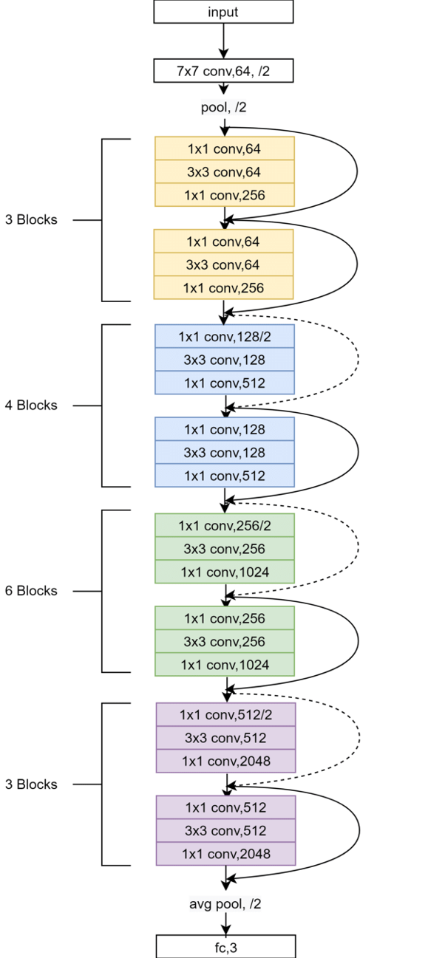

ResNet50 (Freeze Conv Base)
$$+$$

Slide 12
Convolutional Neural Network by ResNet50 - Freeze Conv Base
Step 3.建立ResNet-50的convolutional base及模型，並設定compile
Conv_model = tf.keras.applications.ResNet50(
weights=‘imagenet’,
include_top=False,
input_shape=(180,180,3))
conv_model.trainable = False
下載並加載預訓練的ResNet-50模型
指定用於初始化模型的權重(本例是使用以ImageNet訓練好的參數)
代表要不要包含VGG16頂部的密集連接分類器
提供給神經網路的影像張量的shape，如果不傳遞此參數，則神經網路將能夠處理任何shape的輸入張量
inputs = keras.Input(shape = (180, 180, 3))
x = tf.keras.applications.resnet.preprocess_input(inputs)
x = conv_model(inputs)
x = layers.GlobalAveragePooling2D()(x)
x = layers.Dense(1024, activation='relu')(x)
x = layers.Dropout(0.5)(x)
outputs = layers.Dense(1, activation='sigmoid')(x) model = keras.Model(inputs=inputs, outputs=outputs)
凍結捲積基底的權重
使輸入圖像與模型訓練時使用的圖像具有相同的數據分佈，從而提高預測的準確性和穩定性。
model.compile(loss="binary_crossentropy",
optimizer="rmsprop",
metrics=["accuracy"])
Step 4.建立callbacks並開始訓練模型
callbacks = [
keras.callbacks.ModelCheckpoint(
filepath="CNN_for_ResNet50_freeze",
save_best_only=True,
)]
history_for_ResNet50_freeze = model.fit(
train_dataset,
epochs=30,
validation_data=validation_dataset,
callbacks=callbacks)

Slide 13
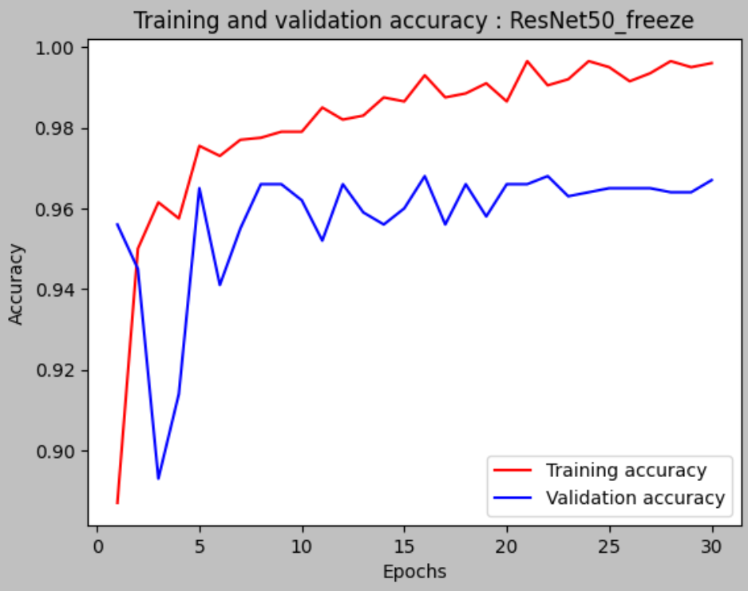
Convolutional Neural Network by ResNet50 - Freeze Conv Base
Step 5.畫出train_data與validation data的accuracy
import matplotlib.pyplot as plt
acc = history_for_ResNet50_freeze.history["accuracy"]
val_acc = history_for_ResNet50_freeze.history["val_accuracy"]
epochs = range(1, len(val_acc) + 1)
plt.plot(epochs, acc, "r", label="Training accuracy")
plt.plot(epochs, val_acc, "b", label="Validation accuracy")
plt.title("Training and validation accuracy : ResNet50_freeze")
plt.xlabel("Epochs")
plt.ylabel("Accuracy")
plt.legend()
plt.show()

Slide 14
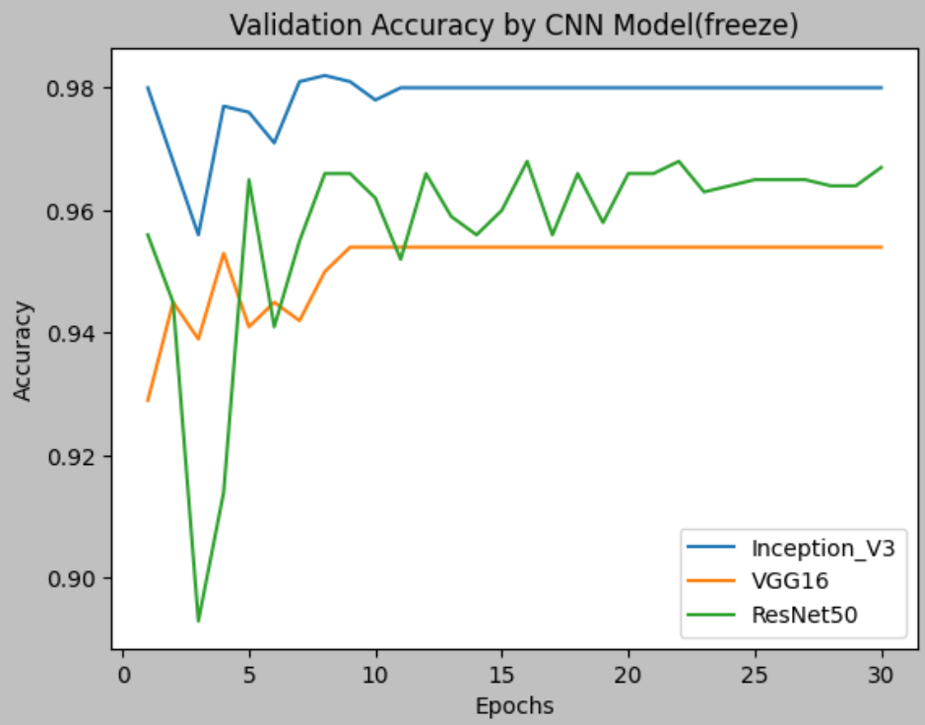
Comparison of Validation Accuracy by Different Models
import matplotlib.pyplot as plt
val_acc_LeNet_freeze = history_for_Inception_V3_freeze.history["val_accuracy"]
val_acc_Inception_V3_freeze = history_for_Inception_V3_freeze.history["val_accuracy"]
val_acc_VGG16_freeze = history_for_VGG16_freeze.history["val_accuracy"]
val_acc_ResNet50_freeze = history_for_ResNet50_freeze.history["val_accuracy"]
epochs = range(1, len(val_acc) + 1)
plt.plot(epochs, val_acc_LeNet_freeze, label="LeNet")
plt.plot(epochs, val_acc_Inception_V3_freeze, label="Inception_V3")
plt.plot(epochs, val_acc_VGG16_freeze, label="VGG16")
plt.plot(epochs, val_acc_ResNet50_freeze, label="ResNet50")
plt.title("Validation Accuracy by CNN Model")
plt.xlabel("Epochs")
plt.ylabel("Accuracy")
plt.legend()
plt.show()
There is no LeNet model in this graph because it does not has pre train model.
It shows Inception_v3 has the best performance when the convolution base was freezed.

Slide 15
Comparison of Validation Accuracy by Freeze or Not
Freeze

Slide 16
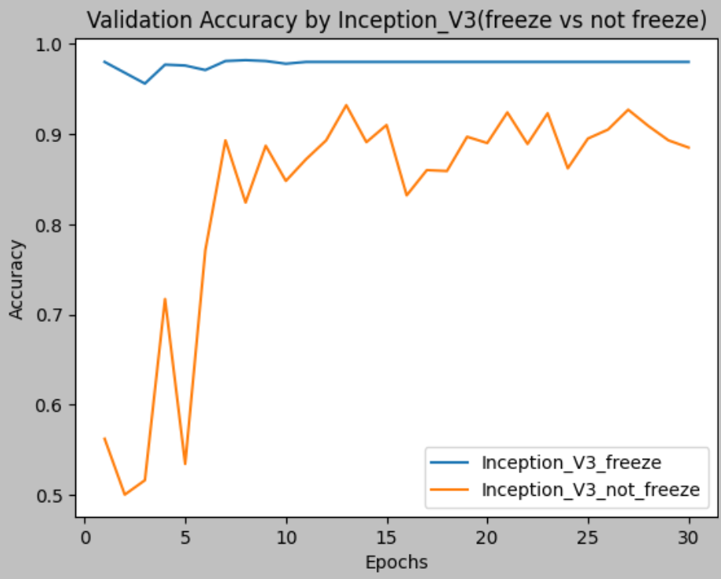
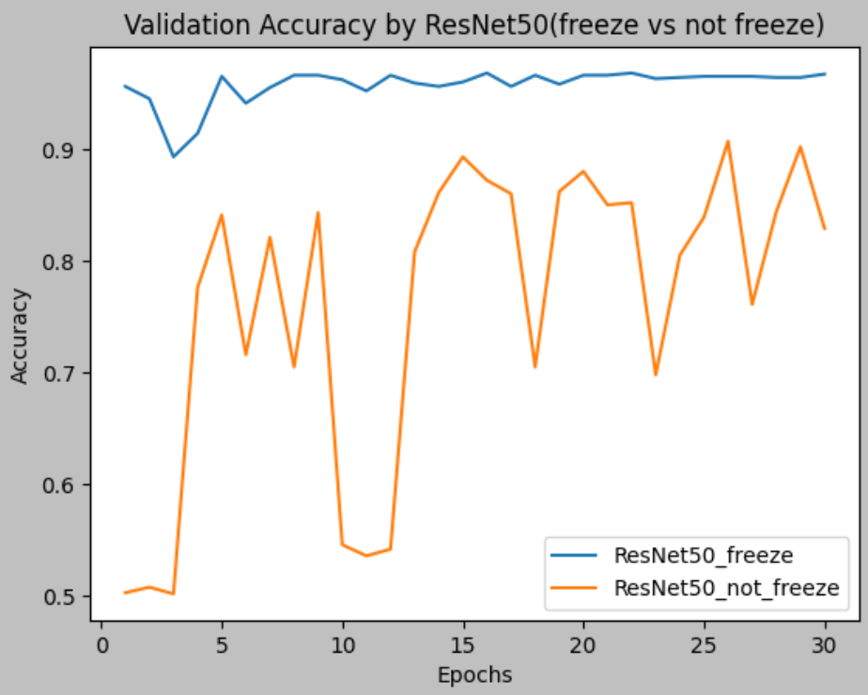
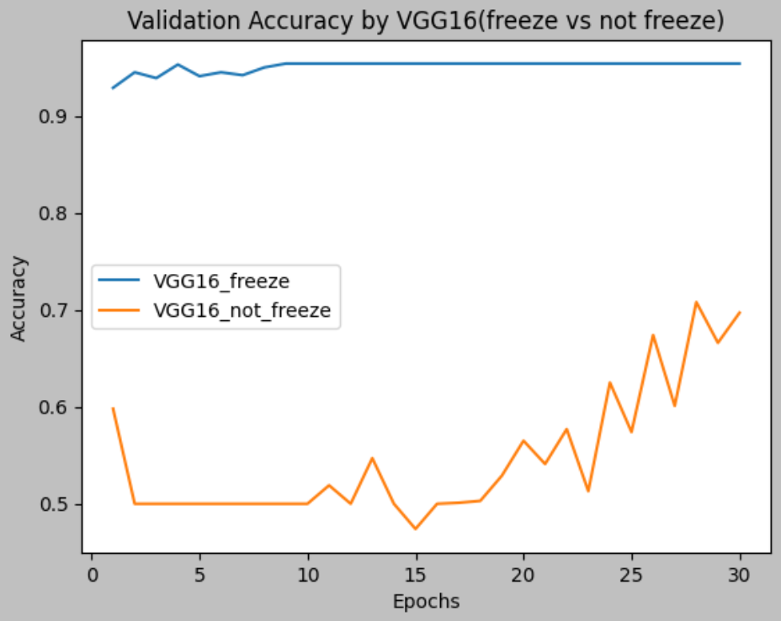
Comparison of Validation Accuracy by Freeze or Not in Different Model
Inception_V3
ResNet50
VGG16
It shows the convolution base of model which was freezed has the better performance than without.

Slide 17
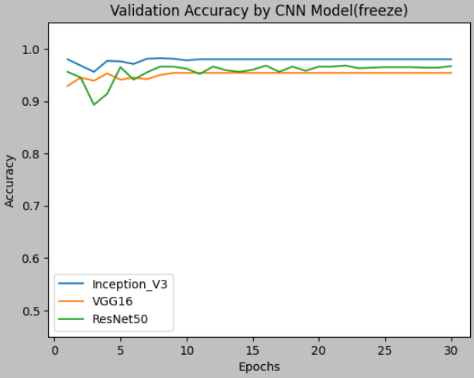
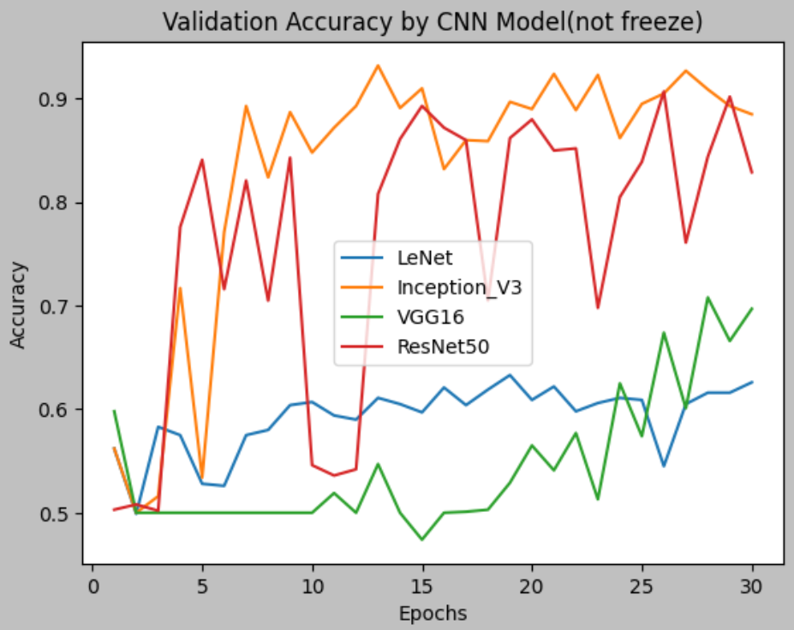
Comparison of Validation Accuracy by Freeze or Not in Different Model
The performance of Inception_V3 is the best regardless of whether the convolutional basis is frozen or not.

Slide 18
Comparison of Validation Accuracy
by Data Augmentation or Not(LeNet)

Slide 19
Convolutional Neural Network by LeNet
Step 3.建立LeNet模型並設定compile
Step 4.建立callbacks並開始訓練模型
from tensorflow import keras
from tensorflow.keras import layers
inputs = keras.Input(shape=(180, 180, 3)) ##LeNet Model
x = layers.Conv2D(filters=32, kernel_size=3, activation="relu")(inputs)
x = layers.MaxPooling2D(pool_size=2)(x)
x = layers.Conv2D(filters=64, kernel_size=3, activation="relu")(x)
x = layers.MaxPooling2D(pool_size=2)(x)
x = layers.Conv2D(filters=128, kernel_size=3, activation="relu")(x)
x = layers.Flatten()(x)
outputs = layers.Dense(1, activation="sigmoid")(x)
model = keras.Model(inputs=inputs, outputs=outputs)
callbacks = [
keras.callbacks.ModelCheckpoint(
filepath="CNN_for_LeNet",
save_best_only=True,
)]
history_for_LeNet = model.fit(
train_dataset,
epochs=30,
validation_data=validation_dataset,
callbacks=callbacks)
model = keras.models.load_model("CNN_for_LeNet")
print(f"Test acc: {model.evaluate(test_dataset)[1]:.3f}")
model.compile(loss="binary_crossentropy",
optimizer="rmsprop",
metrics=["accuracy"])
train_dataset已包含images及labels,故不須輸入labels資料

Slide 20
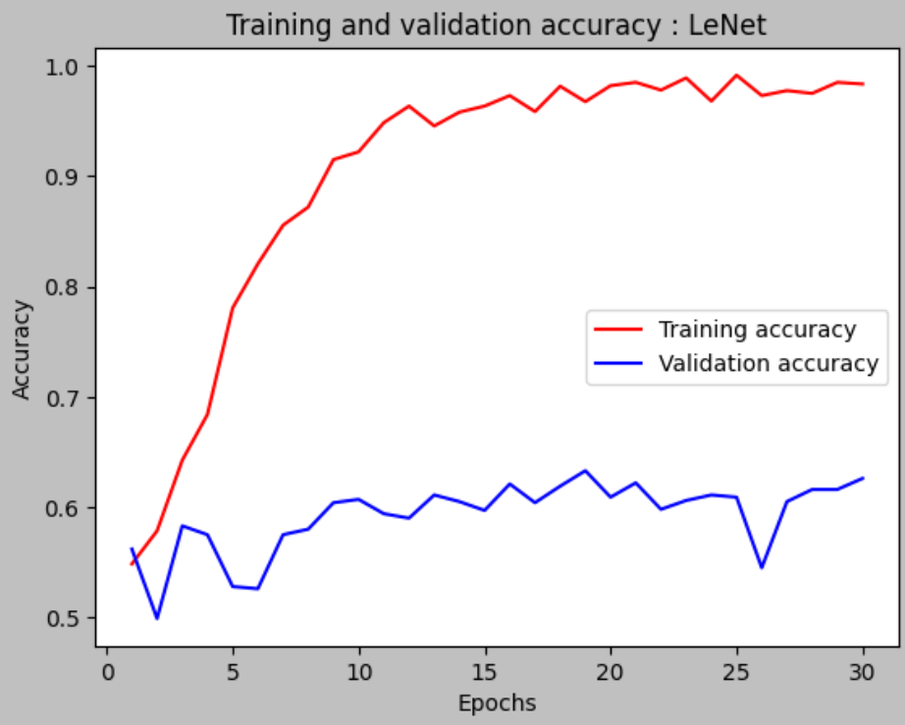
Convolutional Neural Network by LeNet
Step 5.畫出train_data與validation data的accuracy
import matplotlib.pyplot as plt
acc = history_for_LeNet.history["accuracy"]
val_acc = history_for_LeNet.history["val_accuracy"]
epochs = range(1, len(val_acc) + 1)
plt.plot(epochs, acc, "r", label="Training accuracy")
plt.plot(epochs, val_acc, "b", label="Validation accuracy")
plt.title("Training and validation accuracy : LeNet")
plt.xlabel("Epochs")
plt.ylabel("Accuracy")
plt.legend()
plt.show()

Slide 21
Convolutional Neural Network by LeNet included Data Augmentation
Step 3.建立ResNet-50的convolutional base及模型，並設定compile
from tensorflow import keras
from tensorflow.keras import layers
data_augmentation = keras.Sequential(
[
layers.RandomFlip("horizontal"),
layers.RandomRotation(0.1),
layers.RandomZoom(0.2),
layers.RandomContrast(0.2),
layers.RandomBrightness(0.2),
]
)
隨機將50%的輸入影像進行水平翻轉
旋轉輸入影像，角度為[-10%,+10%]範圍內的一個隨機值(以角度為單位則為[-36度,+36度])
放大或縮小影像，幅度為[-20%,+20%]內的一個隨機百分比
隨機調整對比度 [0.8, 1.2]
隨機調整亮度 [0.8, 1.2]
from tensorflow import keras
from tensorflow.keras import layers
inputs = keras.Input(shape=(180, 180, 3))
x = data_augmentation(inputs)
x = layers.Conv2D(filters=32, kernel_size=3, activation="relu")(inputs)
x = layers.MaxPooling2D(pool_size=2)(x)
x = layers.Conv2D(filters=64, kernel_size=3, activation="relu")(x)
x = layers.MaxPooling2D(pool_size=2)(x)
x = layers.Conv2D(filters=128, kernel_size=3, activation="relu")(x)
x = layers.Flatten()(x)
outputs = layers.Dense(1, activation="sigmoid")(x)
model = keras.Model(inputs=inputs, outputs=outputs)
資料擴增
model.compile(loss="binary_crossentropy",
optimizer="rmsprop",
metrics=["accuracy"])

Slide 22
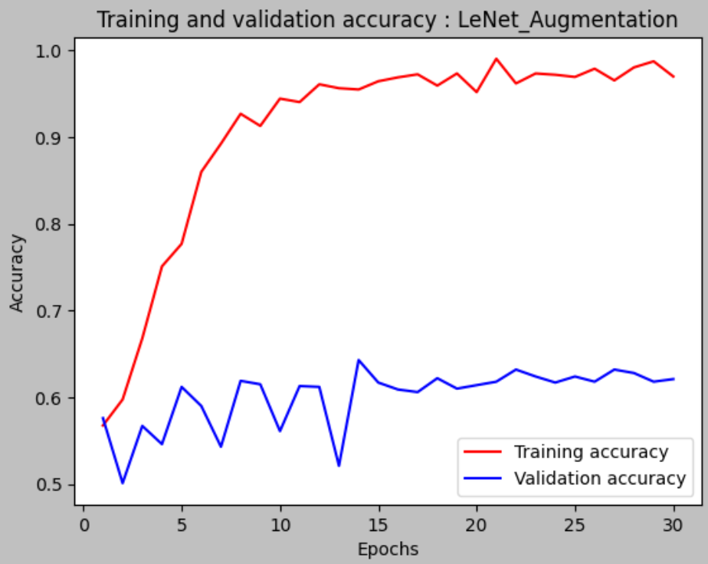
Convolutional Neural Network by LeNet included Data Augmentation
Step 4.建立callbacks並開始訓練模型
callbacks = [
keras.callbacks.ModelCheckpoint(
filepath="CNN_for_LeNet_Augmentation",
save_best_only=True,
)]
history_for_LeNet_Augmentation = model.fit(
train_dataset,
epochs=30,
validation_data=validation_dataset,
callbacks=callbacks)
Step 5.畫出train_data與validation data的accuracy
import matplotlib.pyplot as plt
acc = history_for_LeNet_Augmentation.history["accuracy"]
val_acc = history_for_LeNet_Augmentation.history["val_accuracy"]
epochs = range(1, len(val_acc) + 1)
plt.plot(epochs, acc, "r", label="Training accuracy")
plt.plot(epochs, val_acc, "b", label="Validation accuracy")
plt.title("Training and validation accuracy : LeNet_Augmentation")
plt.xlabel("Epochs")
plt.ylabel("Accuracy")
plt.legend()
plt.show()

Slide 23
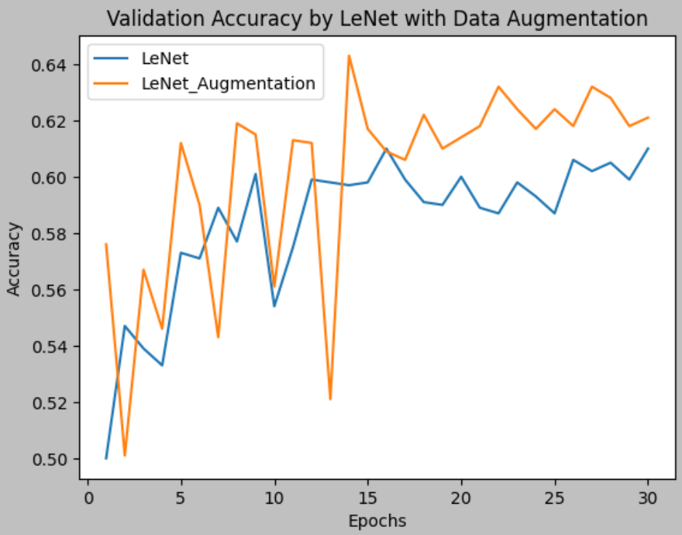
Comparison of Validation Accuracy by Data Augmentation or Not
It shows the model after data augmentation has the better performance in LeNet

Slide 24
Comparison of Validation Accuracy by Different Pre-trained Method

Slide 25
Convolutional Neural Network by VGG16 with Feature Extraction

Slide 26
Convolutional Neural Network by VGG16 with Feature Extraction
Step 3.建立VGG16的convolutional base
conv_base = keras.applications.vgg16.VGG16(
weights="imagenet",
include_top=False,
input_shape=(180, 180, 3))
下載並加載預訓練的VGG16模型
指定用於初始化模型的權重(本例是使用以ImageNet訓練好的參數)
代表要不要包含VGG16頂部的密集連接分類器
Step 4.萃取VGG16的特徵和對應標籤
提供給神經網路的影像張量的shape，如果不傳遞此參數，則神經網路將能夠處理任何shape的輸入張量
import numpy as np
def extract_features_and_labels(dataset):
all_features = []
all_labels = []
for images, labels in dataset:
preprocessed_images = keras.applications.vgg16.preprocess_input(images)
features = conv_base.predict(preprocessed_images)
all_features.append(features)
all_labels.append(labels)
return np.concatenate(all_features), np.concatenate(all_labels)
train_extract_features, train_labels = extract_features_and_labels(train_dataset)
val_extract_features, val_labels = extract_features_and_labels(validation_dataset)
test_extract_features, test_labels = extract_features_and_labels(test_dataset)
將影像資料輸入VGG16捲積基底，萃取VGG16的特徵和對應標籤
train_features.shape
VGG16的最終特徵圖的shape為(5,5,512)

Slide 27
Convolutional Neural Network by VGG16 with Feature Extraction
Step 5.建立和訓練密集連接的分類器
inputs = keras.Input(shape=(5, 5, 512))
x = layers.Flatten()(inputs)
x = layers.Dense(256)(x)
x = layers.Dropout(0.5)(x)
outputs = layers.Dense(1, activation="sigmoid")(x)
model = keras.Model(inputs, outputs)
model.compile(loss="binary_crossentropy",
optimizer="rmsprop",
metrics=["accuracy"])
將特徵圖傳入Dense(密集層)前，要先使用平坦層(Flatten)將其扁平化
Step 6.建立callbacks並開始訓練模型
callbacks = [
keras.callbacks.ModelCheckpoint(
filepath="CNN_for_VGG16_feature_extraction",
save_best_only=True,
monitor="val_loss")
history_for_VGG16_feature_extraction = model.fit(
train_extract_features, train_labels,
epochs=30,
validation_data=(val_extract_features, val_labels),
callbacks=callbacks)
因為資料進行過函數"extract_features_and_labels"的特徵萃取，故需輸入images及labels

Slide 28
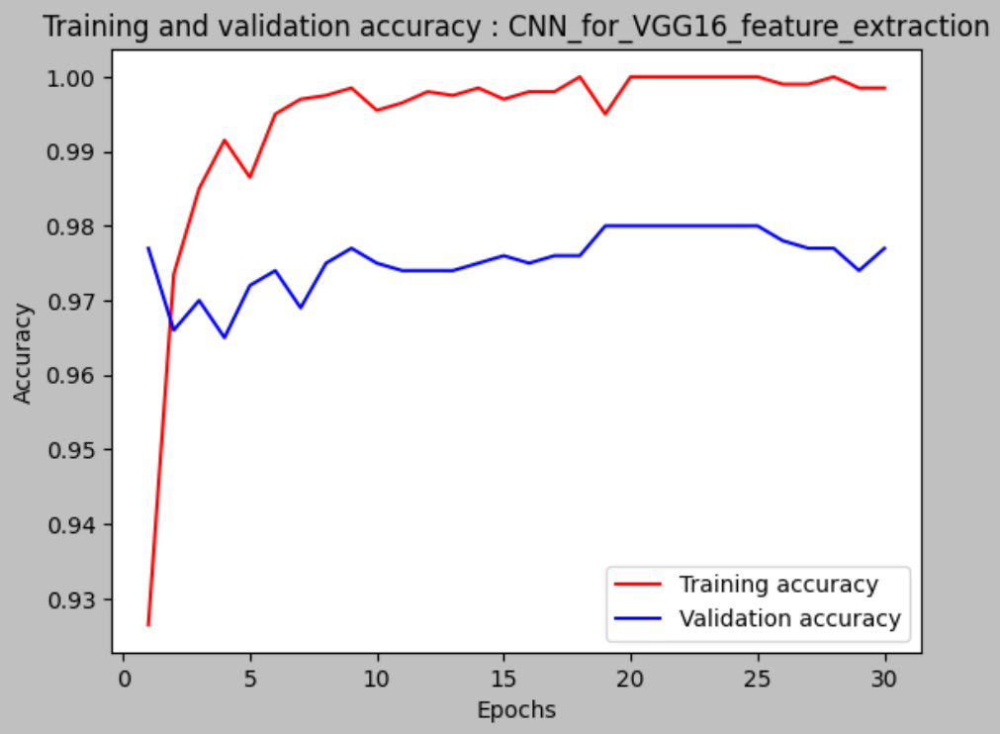
Convolutional Neural Network by VGG16 with Feature Extraction
Step 7.畫出train_data與validation data的accuracy
import matplotlib.pyplot as plt
acc = history_for_VGG16_feature_extraction.history["accuracy"]
val_acc = history_for_VGG16_feature_extraction.history["val_accuracy"]
epochs = range(1, len(val_acc) + 1)
plt.plot(epochs, acc, "r", label="Training accuracy")
plt.plot(epochs, val_acc, "b", label="Validation accuracy")
plt.title("Training and validation accuracy : CNN_for_VGG16_feature_extraction")
plt.xlabel("Epochs")
plt.ylabel("Accuracy")
plt.legend()
plt.show()

Slide 29

Convolutional Neural Network by VGG16 with Freeze Conv Base
$$+$$

Slide 30
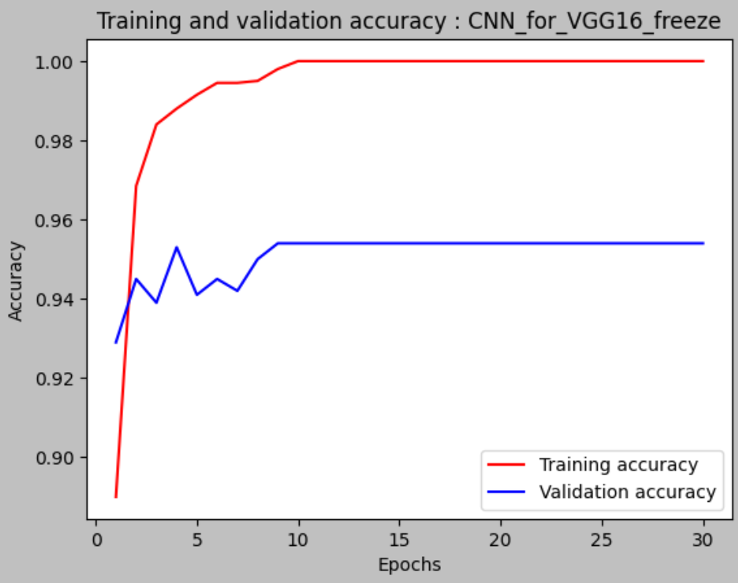
Convolutional Neural Network by VGG16 with Freeze Conv Base
P.S. Use previous results from pages 9 to 11.

Slide 31
Convolutional Neural Network by VGG16 with Fine Tune

Slide 32
Convolutional Neural Network by VGG16 with Fine Tune
Step 3.建立VGG16的convolutional base並凍結捲積基底weights
conv_base = keras.applications.vgg16.VGG16(
weights="imagenet",
include_top=False,
input_shape=(180, 180, 3)
)
conv_base.trainable = False
下載並加載預訓練的VGG16模型
指定用於初始化模型的權重(本例是使用以ImageNet訓練好的參數)
代表要不要包含VGG16頂部的密集連接分類器
提供給神經網路的影像張量的shape，如果不傳遞此參數，則神經網路將能夠處理任何shape的輸入張量
凍結捲積基底的權重
Step 4.新增一個分類器並設定compile
inputs = keras.Input(shape=(180, 180, 3))
x = keras.applications.vgg16.preprocess_input(inputs)
x = conv_base(x)
x = layers.Flatten()(x)
x = layers.Dense(256)(x)
x = layers.Dropout(0.5)(x)
outputs = layers.Dense(1, activation="sigmoid")(x)
model = keras.Model(inputs, outputs)
model.compile(loss="binary_crossentropy",
optimizer="rmsprop",
metrics=["accuracy"])
使輸入圖像與模型訓練時使用的圖像具有相同的數據分佈，從而提高預測的準確性和穩定性。
model.compile(loss="binary_crossentropy",
optimizer="rmsprop",
metrics=["accuracy"])

Slide 33
Convolutional Neural Network by VGG16 with Fine Tune
Step 5.預訓練模型
model.fit(
train_dataset,
epochs=30,
validation_data=validation_dataset,
)
Step 6.將所有層凍結到指定層為止
conv_base.trainable = True
for layer in conv_base.layers[:-4]:
layer.trainable = False
先設定所有層為可訓練
把conv_base最後第4層前的所有層設定為不可訓練
Step 7.微調神經網路
model.compile(loss="binary_crossentropy",
optimizer=keras.optimizers.RMSprop(learning_rate=1e-5),
metrics=["accuracy"])
callbacks = [
keras.callbacks.ModelCheckpoint(
filepath="fine_tuning.keras",
save_best_only=True,
monitor="val_loss")
]
history = model.fit(
train_dataset,
epochs=30,
validation_data=validation_dataset,
callbacks=callbacks)

Slide 34
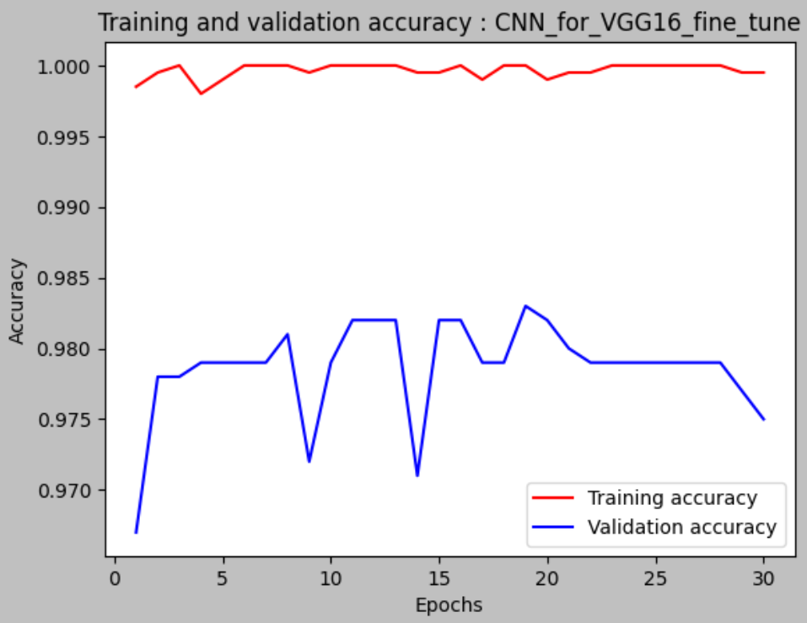
Convolutional Neural Network by VGG16 with Fine Tune
Step 8.畫出train_data與validation data的accuracy
import matplotlib.pyplot as plt
acc = history_for_VGG16_fine_tune.history["accuracy"]
val_acc = history_for_VGG16_fine_tune.history["val_accuracy"]
epochs = range(1, len(val_acc) + 1)
plt.plot(epochs, acc, "r", label="Training accuracy")
plt.plot(epochs, val_acc, "b", label="Validation accuracy")
plt.title("Training and validation accuracy : CNN_for_VGG16_fine_tune")
plt.xlabel("Epochs")
plt.ylabel("Accuracy")
plt.legend()
plt.show()

Slide 35
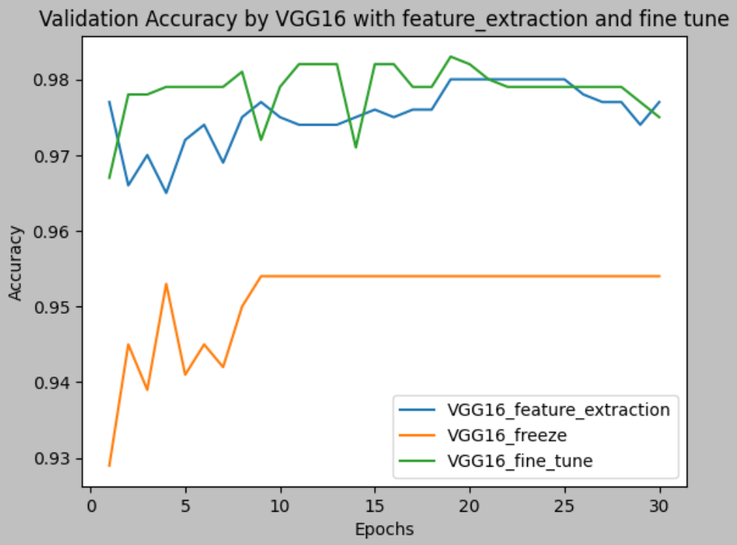
Comparison of Validation Accuracy by Different Pre-trained Method
It shows the fine tune method has the better performance in VGG16

